Slide 1

AL-FARABI KAZAKH NATIONAL UNIVERSITY
Department of political science and political technologies
Working practices of international organizations
Abzhapparova A.A.
Senior lecturer

Slide 2
Working practices of international organizations
Lecture 6
Mission and structure of Global organizations

Slide 3


GLOBAL
REGIONAL

Slide 4

●Trade
●Economic growth
●Cooperation
●Investments

Slide 5
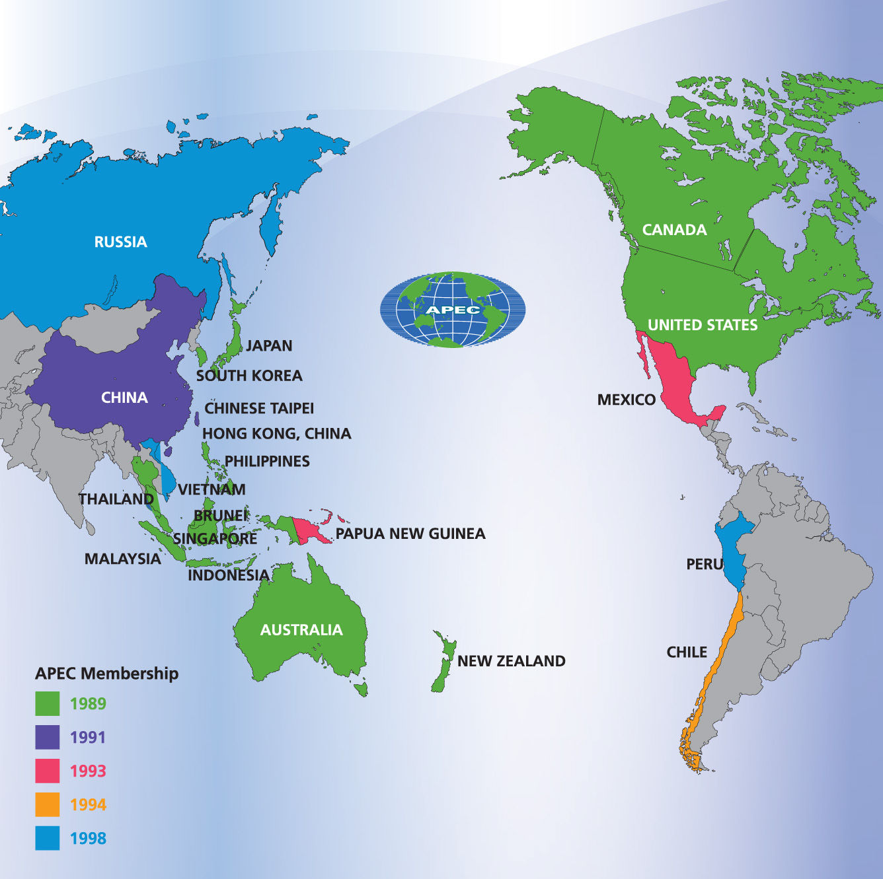

Slide 6
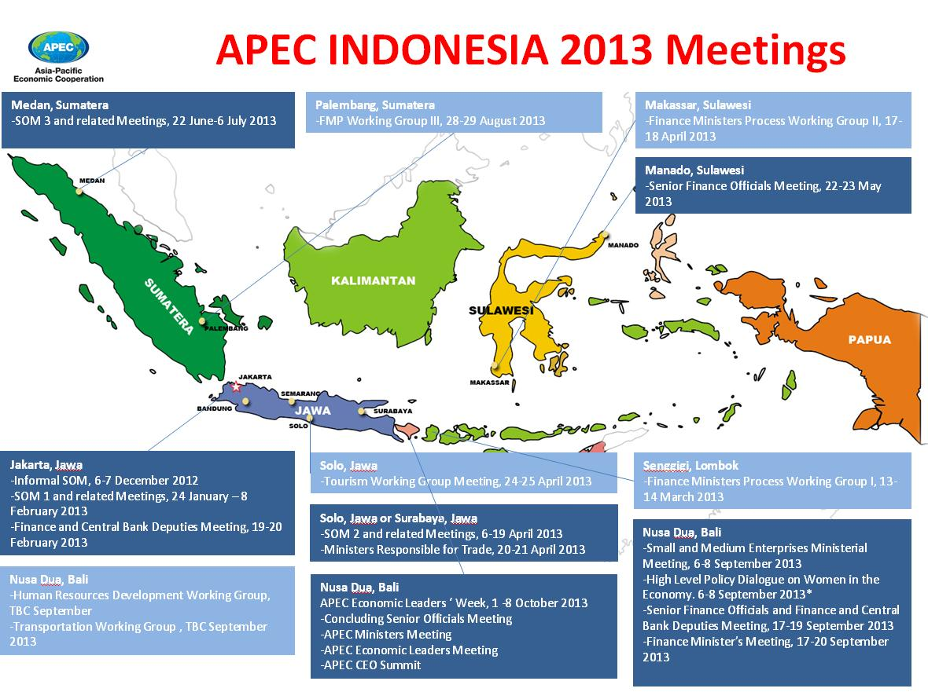

Slide 7
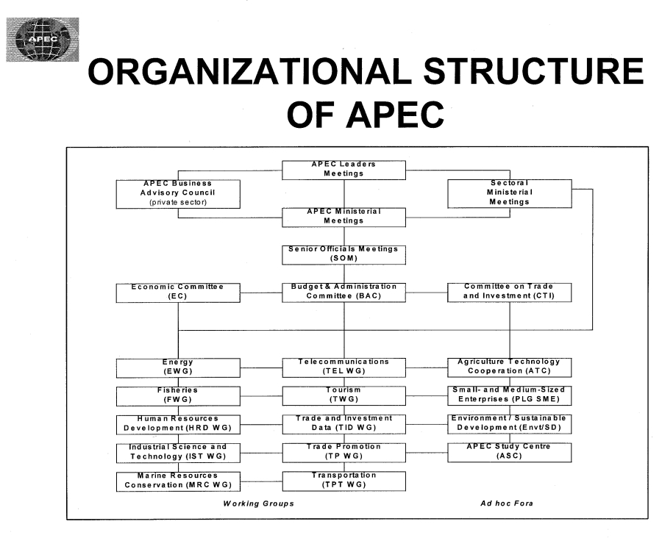

Slide 8

OPEC
OPEC
Organization of Petroleum Exporting Countries

Slide 9
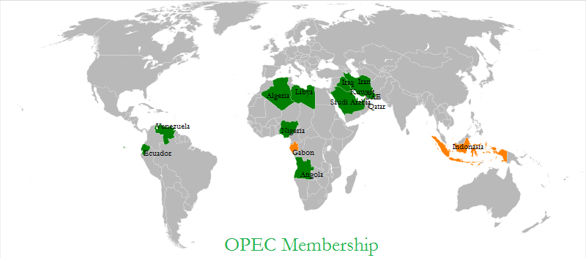

Slide 10




Slide 11


Slide 12
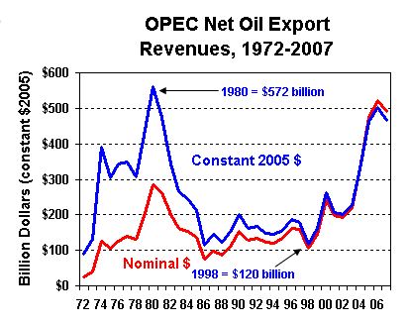

Slide 13

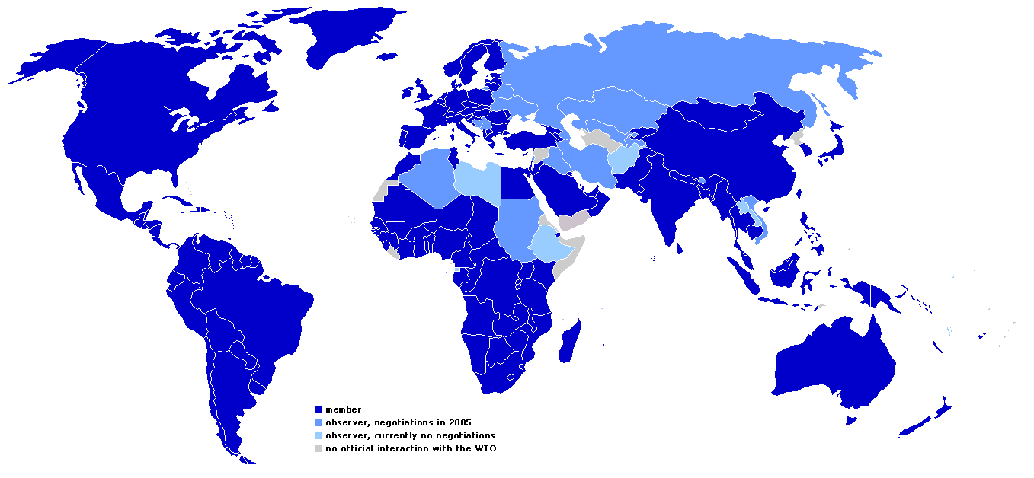

Slide 14
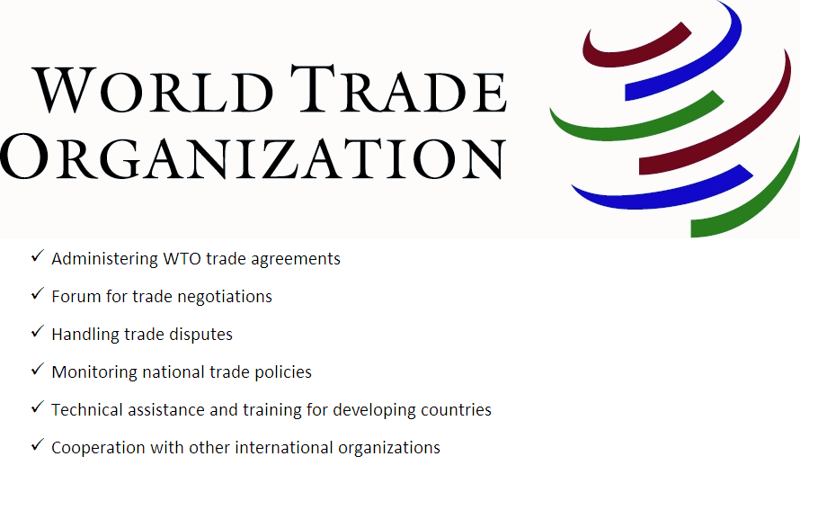

Slide 15
WTO can…
1 ... cut living costs and raise living standards
2 ... settle disputes and reduce trade tensions
3 ... stimulate economic growth and employment
4 ... cut the cost of doing business internationally
5 ... encourage good governance
6 ... help countries develop
7 ... give the weak a stronger voice
8 ... support the environment and health
9 ... contribute to peace and stability
10 ... be effective without hitting the headlines

Slide 16
General Agreement on Tariffs and Trade (GATT)
1986–1994
WTO
1995

Slide 17
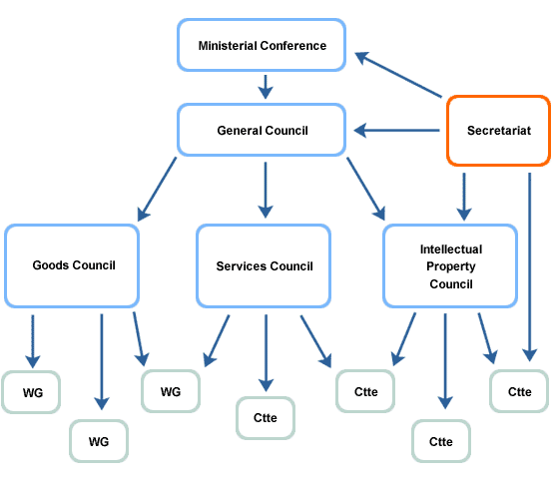

Slide 18

African Union (AU), 1999

Slide 19
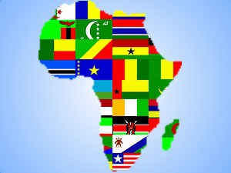
54 Member States

Slide 20
“An integrated, prosperous and peaceful Africa, driven by its own citizens and representing a dynamic force in global arena.”
To achieve greater unity and solidarity between the African countries;
To defend the sovereignty, territorial integrity and independence;
To encourage international cooperation, taking due account of the Charter of the United Nations and the Universal Declaration of Human Rights;
To promote peace, security, and stability on the continent;
To promote peace, security, and stability on the continent;
To promote sustainable development at the economic, social and cultural levels as well as the integration of African economies;

Slide 21
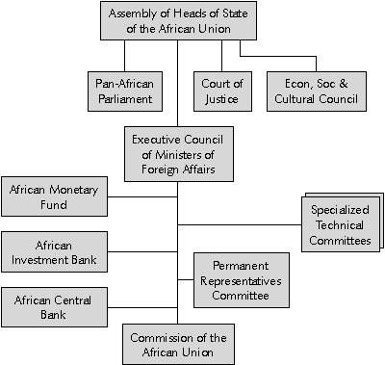

Slide 22


African Charter on Human and People’s Rights (Nairobi 1981)

Slide 23
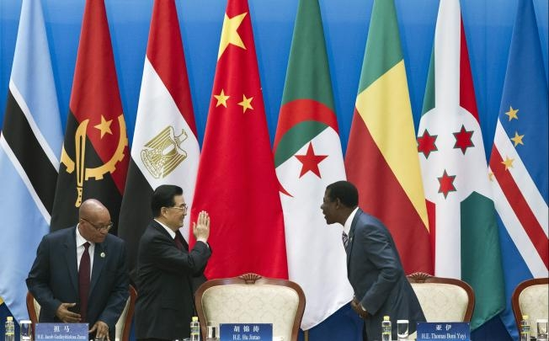

Slide 24

●peace
●stability
●democracy
The European Union (EU), 1993

Slide 25
European Economic Community, 1958
European Union, 1993

Slide 26
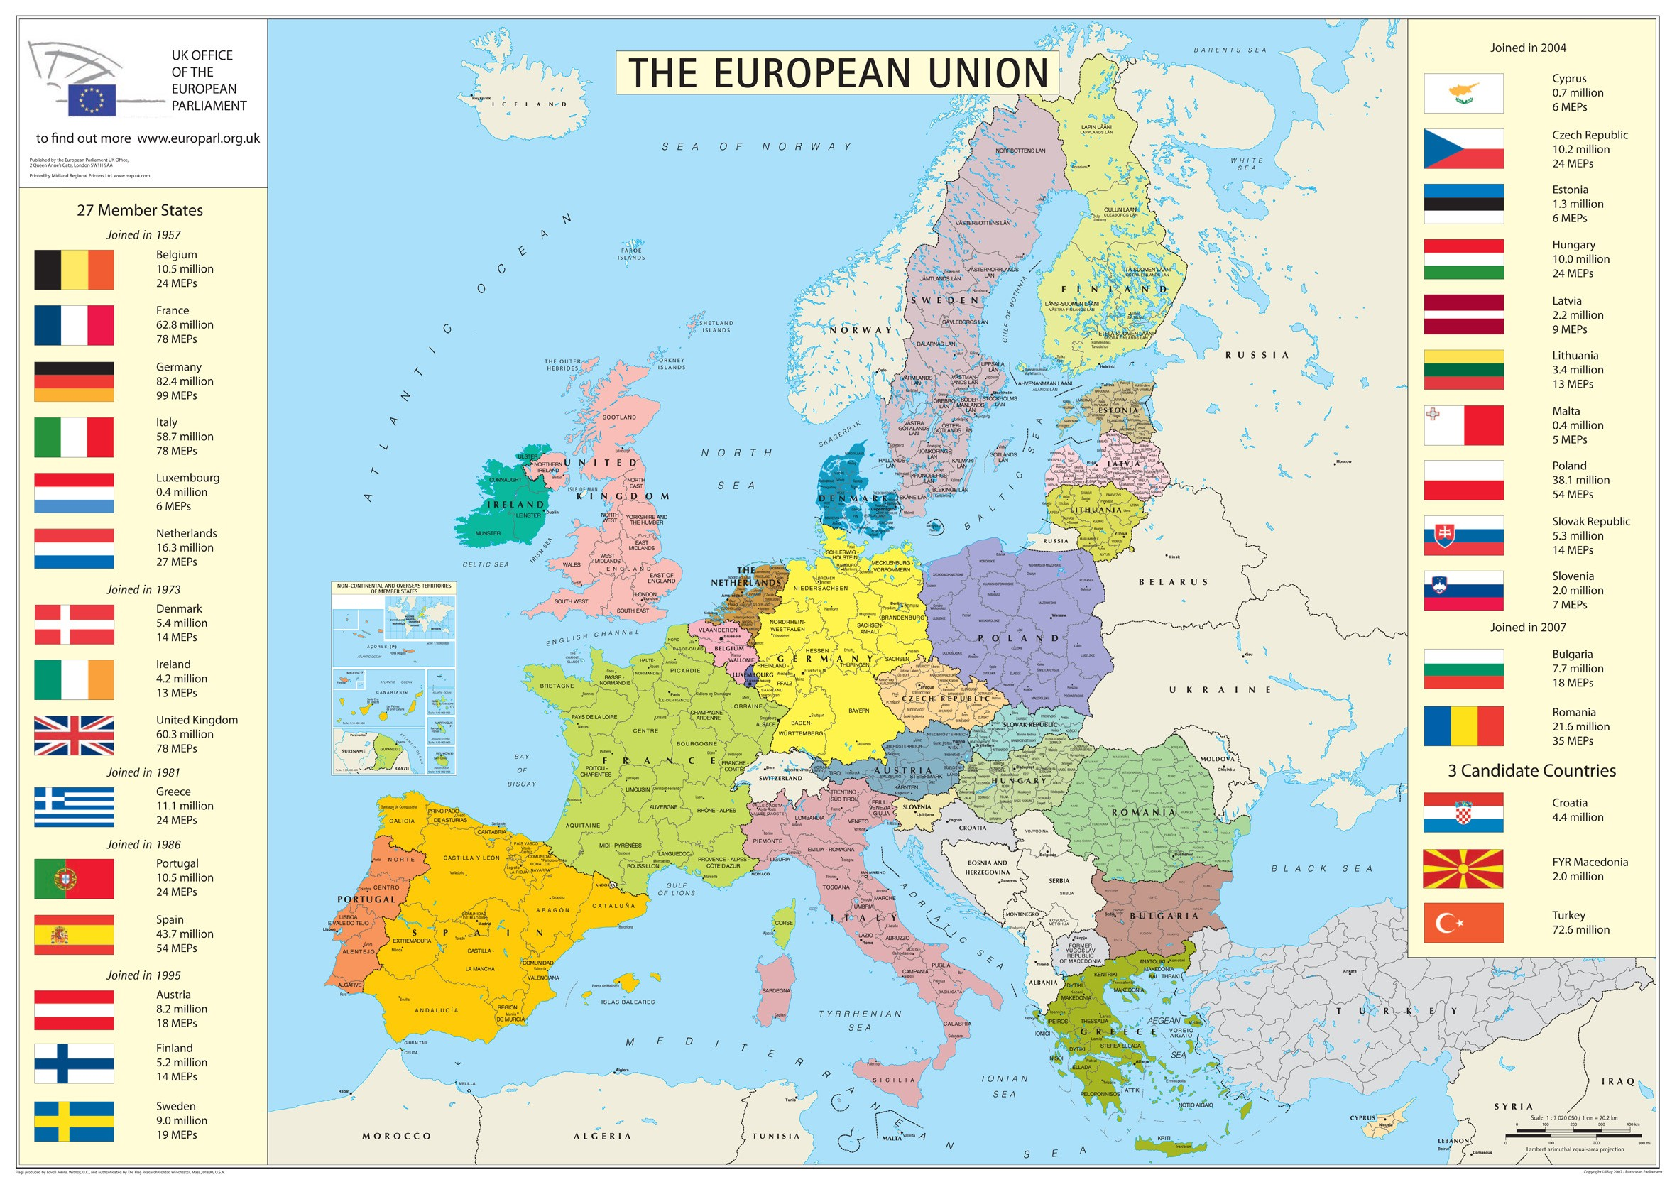

Slide 27





Slide 28
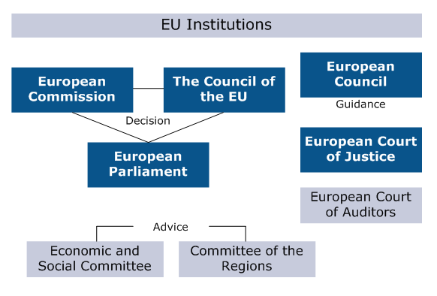

Slide 29

Association of Southeast Asian Nations

Slide 30
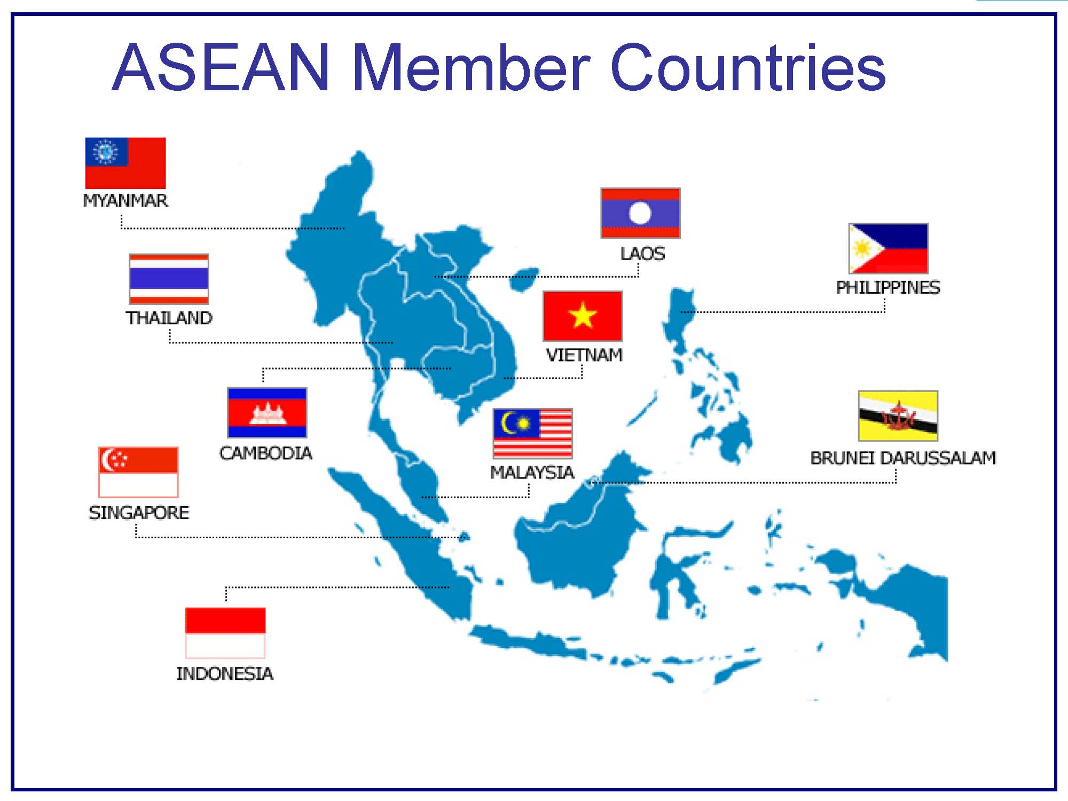

Slide 31

- provide for greater efficiency in the coordination of ASEAN organs and for more effective implementation of ASEAN projects and activities.
- initiate, facilitate and coordinate ASEAN stakeholder collaboration in realising the purposes and principles of ASEAN as reflected in the ASEAN Charter.

Slide 32

cooperation in the area of political and security cooperation has been deepened by regular dialogue and exchange of views

Slide 33
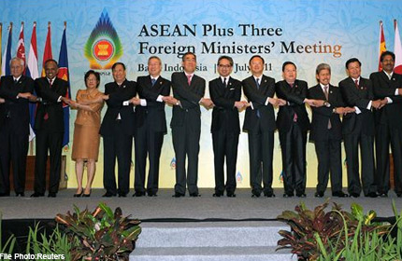

Slide 34

North-Atlantic Treaty Organization (NATO),
1949

Slide 36
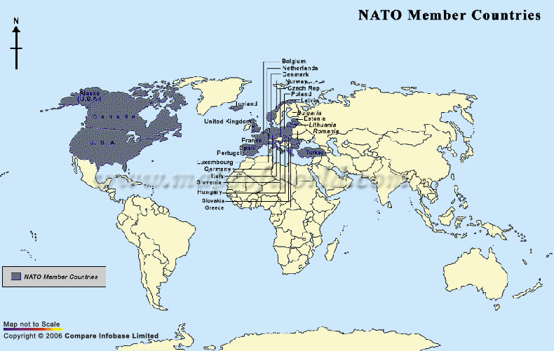

Slide 37
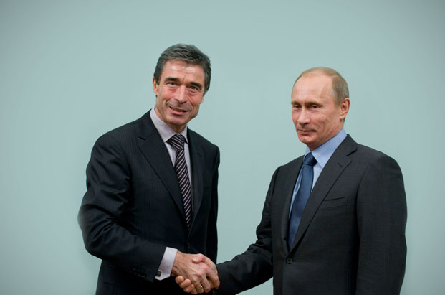
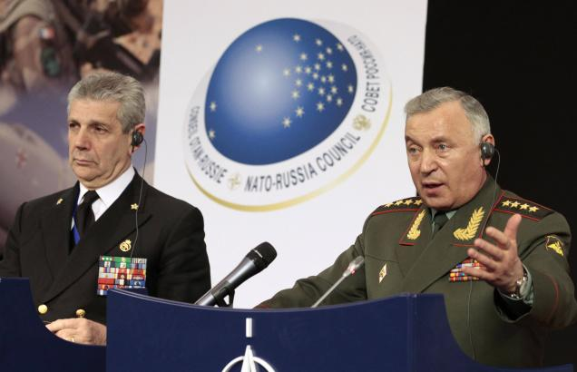
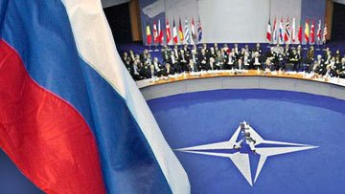
NATO-RUSSIA COUNCIL

Slide 38

To stop:
●drug trafficking
●terrorism
●extremism
Shanghai Cooperation Organization, 1996

Slide 39
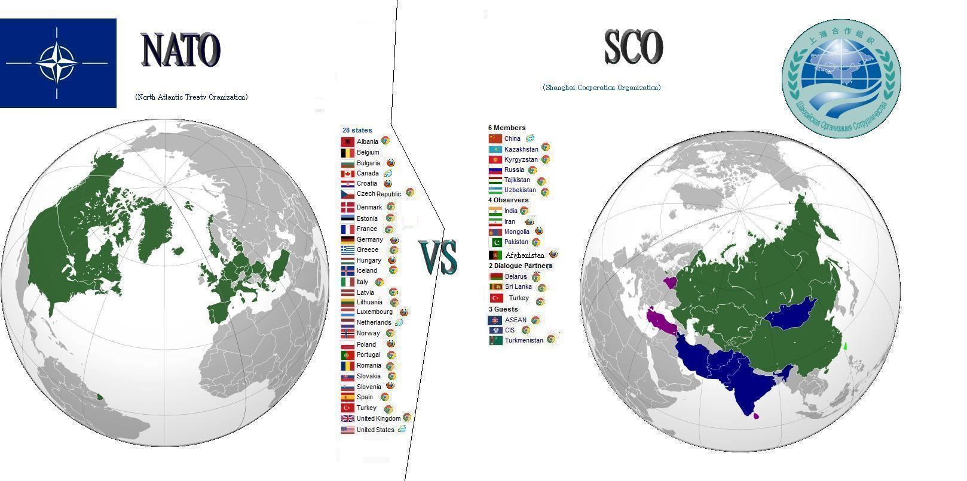

Slide 40
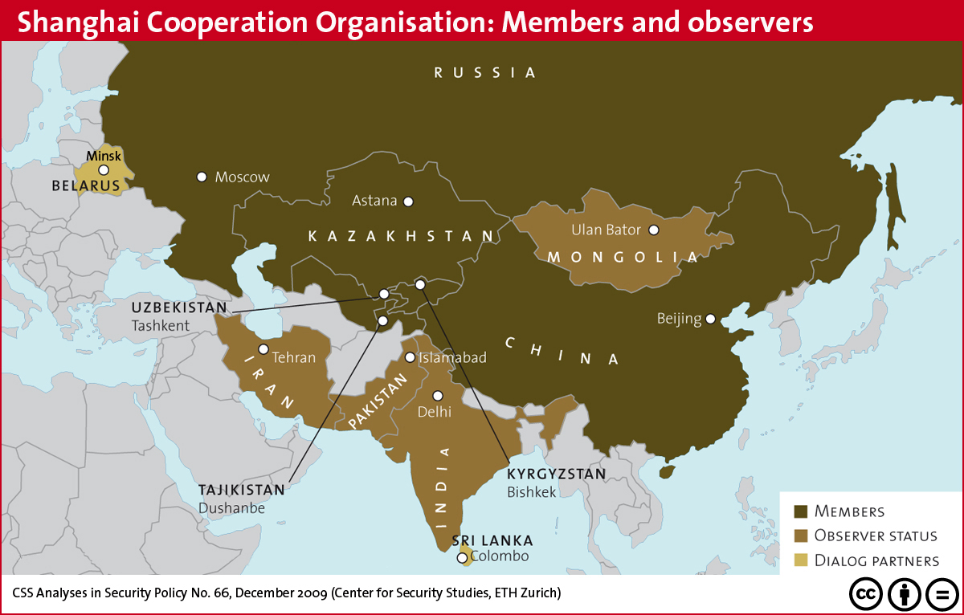

Slide 41
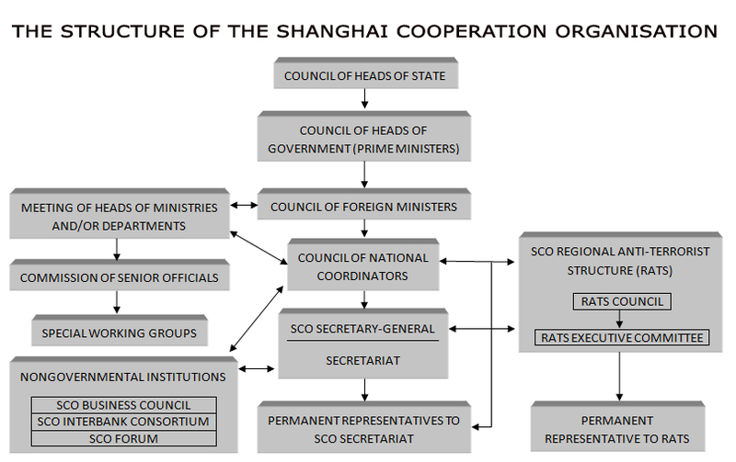

Slide 42
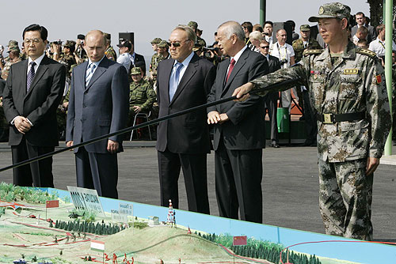
Putin and Hu Jin Tao - Peace Keeping Mission 2007

Slide 43
Conference on Security and Cooperation in Europe (CSCE)
Helsinki Final Act, 1975
Organization for Security and Co-operation in Europe (OSCE)
1994

Slide 44
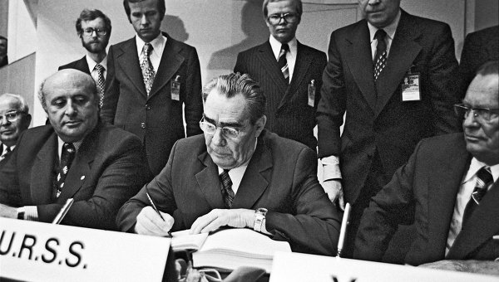
Helsinki Final Act
Sovereign equality, respect for the rights inherent in sovereignty
Refraining from the threat or use of force
Inviolability of frontiers
Territorial integrity of States
Peaceful settlement of disputes
Non-intervention in internal affairs
Respect for human rights and fundamental freedoms, including the freedom of thought, conscience, religion or belief
Equal rights and self-determination of peoples
Co-operation among States
Fulfilment in good faith of obligations under international law

Slide 45
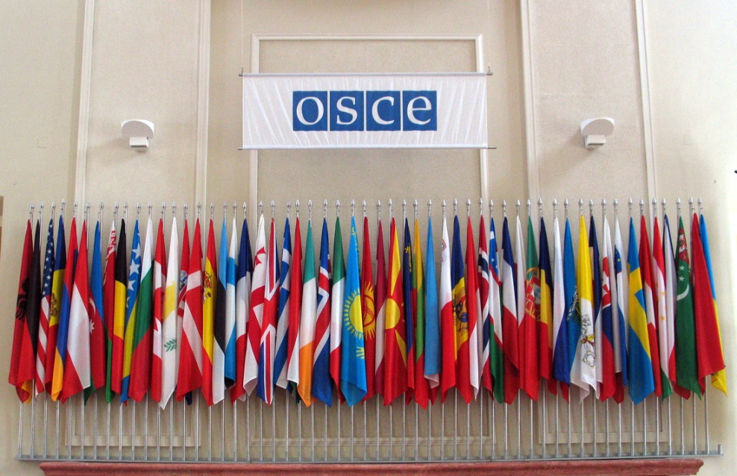

early warning,
conflict
prevention,
crisis management
post-conflict monitoring

Slide 46
Organization for Security and Co-operation in Europe (1994)
57 States from Europe, Central Asia and North America;
World's largest regional security organization;
Comprehensive approach to security that encompasses politico-military, economic and environmental, and human aspects.

Slide 47
Main directions of work:
Arms control
Combating human trafficking
Combating terrorism
Economic activities
Human rights

Slide 48

League of Arab States

Slide 49
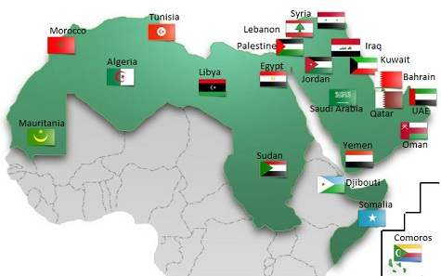

Slide 50


Slide 51
Thank you for attention!

